Slide 1
Neural Networks: How, When, and What?
A Technical Approach

Slide 2
Overview of the talk
What’s the goal of this talk?
How does a neural network work?
When does it make sense to use a neural network?
What does the neural network pipeline look like?
Some follow up thoughts on the whole mess

Slide 3
What’s the goal of this talk?

Slide 4
First goal
There are plenty of handy-wavy blogs
There are plenty of higher-level applications talks
How do a neophyte comfortably transition from hand-waving to application?
How should a custom neural network be constructed?

Slide 5
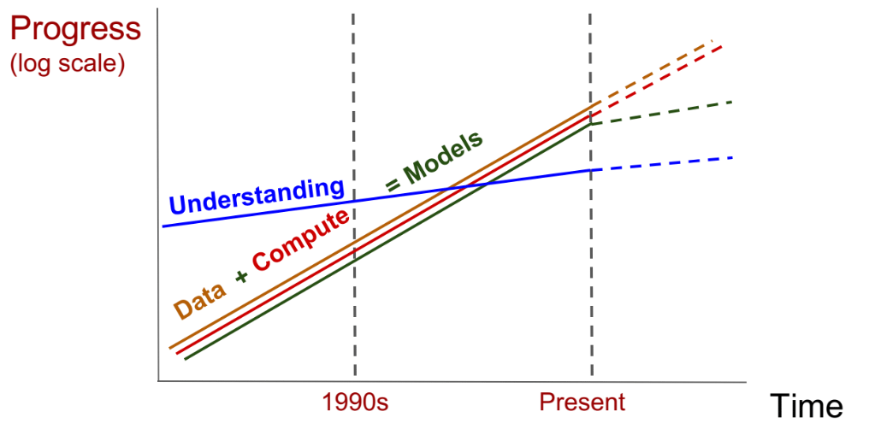
Second goal
There is a lot of focus on applications
We’re approaching a turning point
I want to inspire a focus on the theory rather than just the experiment
Source: Maithra Raghu (Cornell)

Slide 6
Assumptions
You’ve read some pop deep learning blogs
Familiarity with core concepts such as ‘layers’ and ‘neurons’/’activation functions’
Have a propensity for math
Ideally, a bit of linear algebra under your belt
Aiming to be self-contained, but ‘technobabble’ can be disorienting

Slide 7
How does a neural network work?

Slide 8

What does a neural net even do?
It learns a function.
Yes. That is all.
A function is a map/table/rule/whatever you want to call it that associates elements of one set with elements of another set:
Need to understand more traditional techniques to understand its value

Slide 9

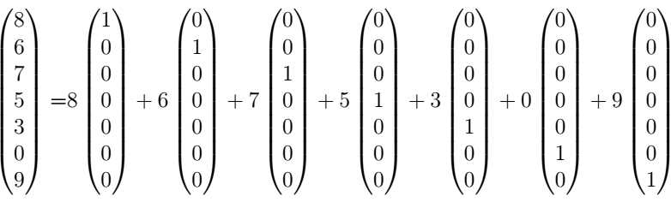
So what’s new?
There are lots of methods to learn a function
My weapon of choice: basis expansions
Functions are vectors (867-5309)
Vectors can be written in terms of other vectors:

Slide 10


Functions
So, funcs can be written in terms of other funcs:
A complicated thing = bunch of simple things
Kind of like making an ensemble model
Computers don’t like infinity, so approximate:

Slide 11

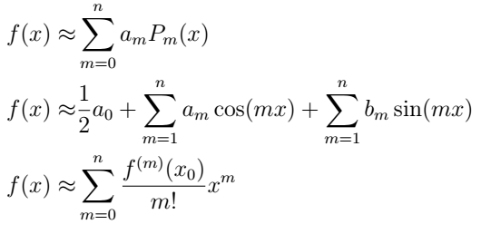
So?
Need to pick a set of φ’s
In physics, we have the luxury of, well, physics
Eigenfunction provide an orthogonal basis:
D embeds some salient physics of the system we wish to model
But what if we don’t know D a priori?
Legendre
Fourier
Taylor

Slide 12

The coefficients
Need to also find $a_{m}$
This is where the loss function comes in
Make the approximation as close to f(x) as possible
Training schemes are a heavy focus within deep learning
LMS (Linear algebra), Cross entropy (stats/information theory)
SGD, RMSProp, Adagrad, Adam, etc.
RL, GANs

Slide 13
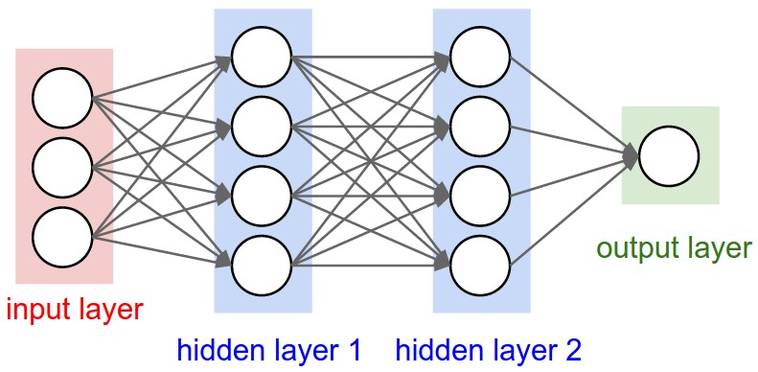

Neural Networks
Each layer in a neural network outputs a linear combination of functions
Neural networks have a nested function structure:

Slide 14
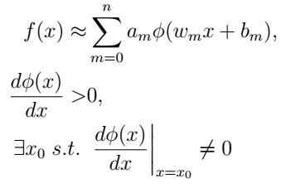

The Universal Approximation Theorem
Neural networks work because of the UAT
Approximate a func:
Monotonic activation:
Nonlinear:
Each layer is just a basis expansion!
The value added: they learn the “best” basis to learn a function!

Slide 15
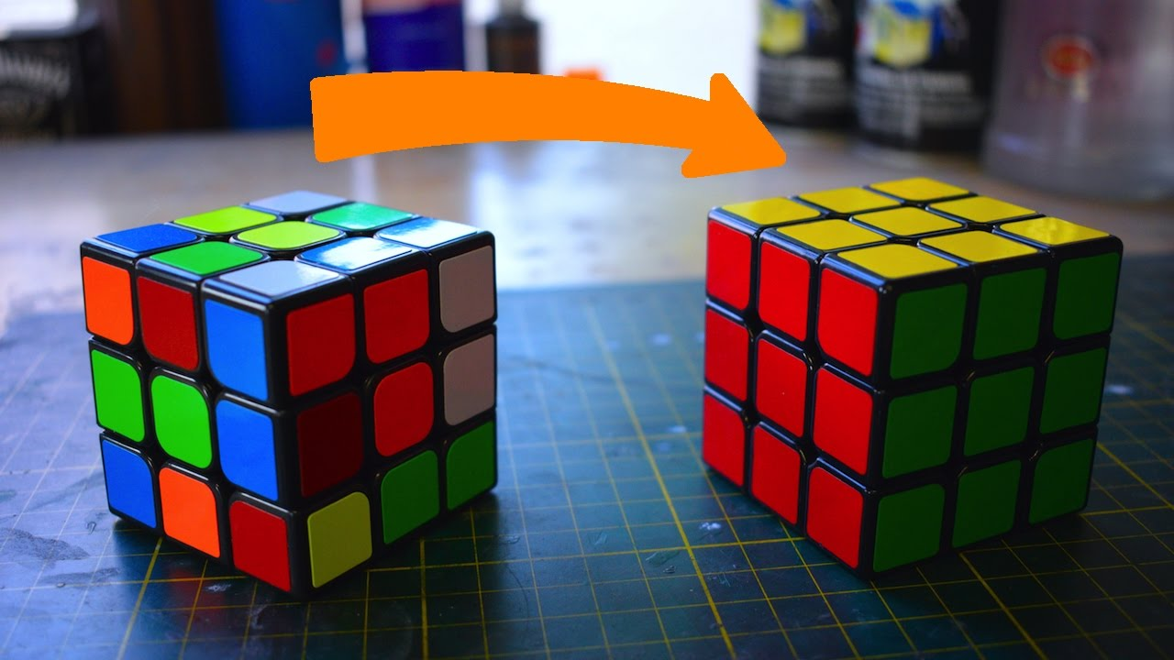
Inter- vs Intra- layer
Intra-layer: linear algebra
Inter-layer?
Occasionally group theory
Can be motivated heuristically
Solving a rubix cube is hard
Solving a single face is easier

Slide 16
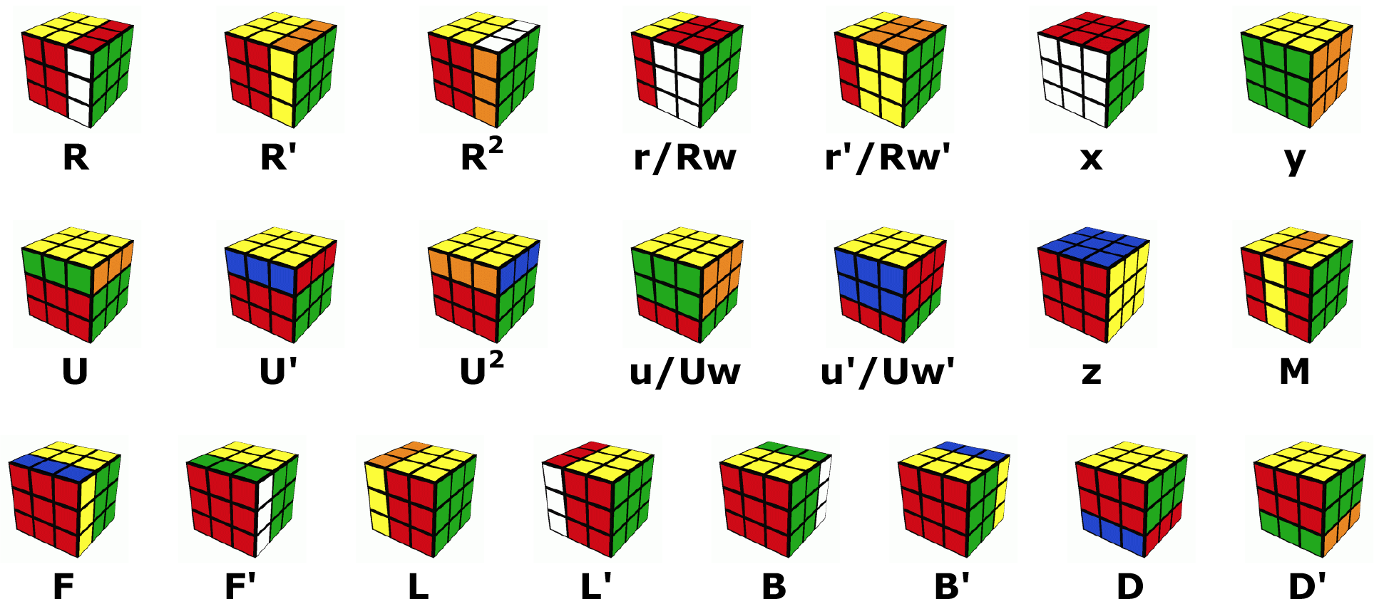
Sequence of simpler functions = Layers
Source: Max Deutsch

Slide 17
Recap
Neural networks learn functions
Many layers break the function down into simpler sequences/problems
Layer structure can be motivated heuristically by appealing to how we solve problems
“Generally”, more layers = each layer solving an easier problem
Each layer is a novel basis expansion
The real differentiator from traditional methods
More neurons in a layer = better solution to the problem that layer solves
You now have the tools to think outside the box and design custom neural networks

Slide 18
When does it make sense to use a neural network?

Slide 19


What about multiple dimensions?
Few problems will involve only a single variable
Traditional basis expansions*:
Number of model parameters grows exponentially:
*Can do better than this given the luxury of up front analysis/symmetries

Slide 20
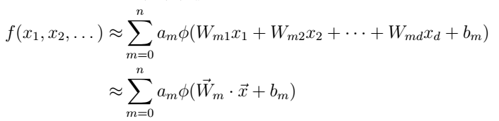

Multiple dimensions cont.
Neural Networks:
Number of model parameters grows linearly:

Slide 21
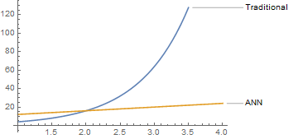
Traditional vs Neural Network
n=4

Slide 22

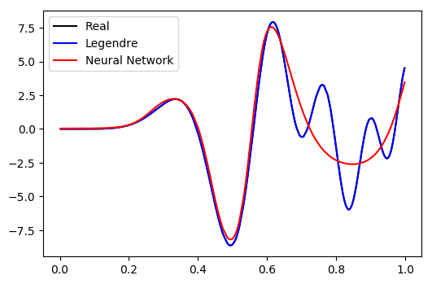
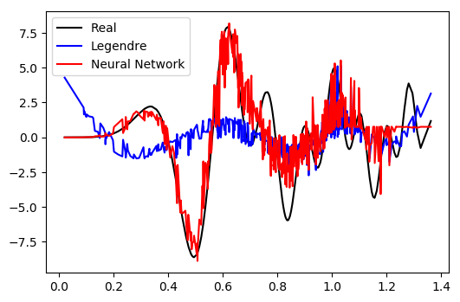
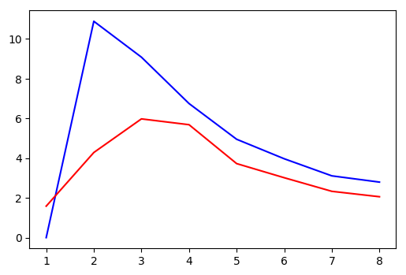
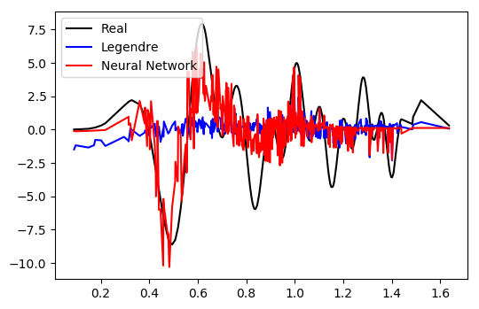
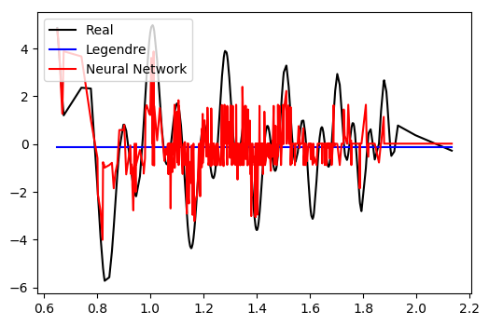
True comparison: Legendre vs Neural Net
1D
2D
3D
6D

Slide 23

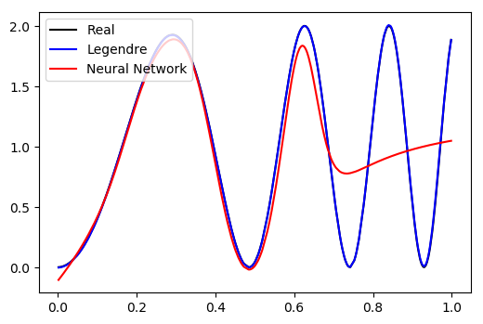
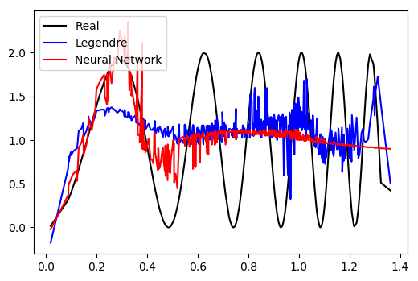
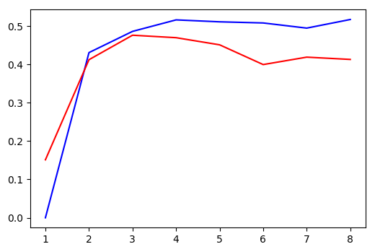
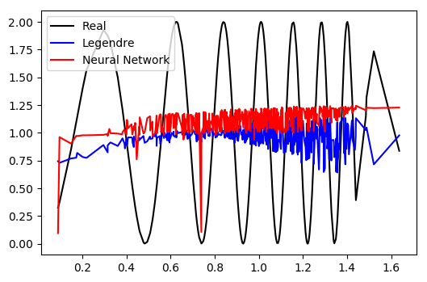
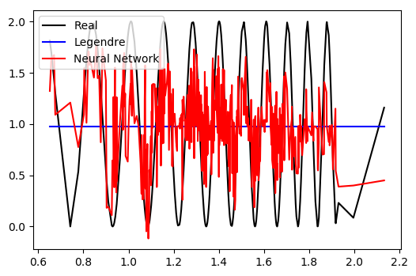
True comparison cont…
1D
2D
3D
6D

Slide 24

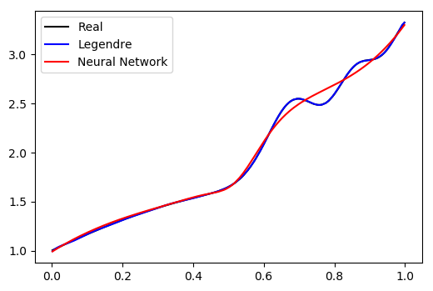
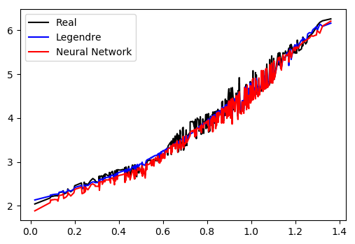
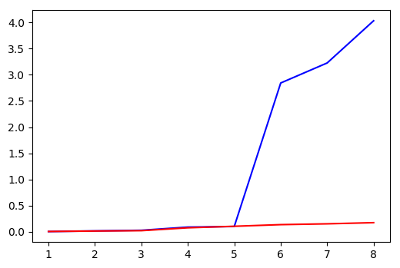
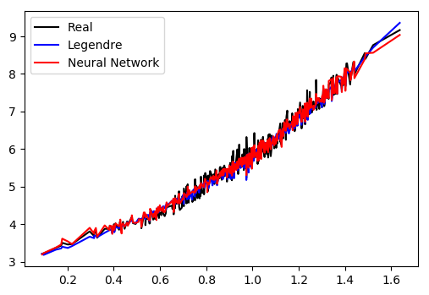
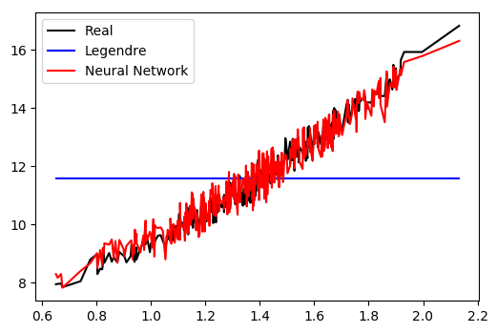
The True True comparison
1D
2D
3D
6D

Slide 25
When to use them!
Neural networks excel at high dimensional data and when optimal basis is not manifestly apparent
Upshot: Lots of model parameters (but not as many as traditional methods)
Generally, need 10-100x the amount of data as the number of model parameters
Upshot: BIG DATA

Slide 26
What does the neural network pipeline look like?

Slide 27
The Pipeline
ID the problem
{
Getting data
{
Usual data
science stuff
Cleaning data
Neural network
stuff - theory
Batching and padding data
Create network architecture
Very important in NNs,
Tensors can’t be ragged
arrays
{
Create training queues if necessary
Neural network
stuff – ‘experiment’
Specify hyper parameters
Train

Slide 28
The tools
Keras:
Incredibly simple – create and train a network in 6 lines
Restricted (mostly) to cookie cutter networks
Tensorflow:
Highly customizable – very powerful port of numpy library to create anything you want
Computations must be created as a static graph
PyTorch:
Dynamic graph!
New

Slide 29
Example pipeline (details not important)
Usual stuff:
def myfunc(x,a,b,n):
terms = [a**m * sp.special.jv(m,b**m * 3.14 * x) for m in range(n)]
return sum(terms)
x_ = [np.random.uniform(0.,1.,size=[data_num , n + 1]) for n in range(dim_num)]
y_myfunc = [np.sum(myfunc(x,2.,1.5,4),axis=1) for x in x_]

Slide 30

Example pipline
Theory:
def neural_net(x,neuron_no,dim):
W = tf.Variable(tf.random_uniform(minval = -1., maxval = 1., shape = [neuron_no, dim]))
b = tf.Variable(tf.random_uniform(minval = -1., maxval = 1., shape = [neuron_no]))
N = tf.Variable(tf.random_uniform(shape = [neuron_no]))
return tf.einsum('i,ji->j', N, tf.tanh(tf.einsum('ij,kj->ki', W, x_place) + b))
I usually find tanh better than ReLu

Slide 31
Example pipeline
Hyper parameters:
dim_num = 12 ## Max number of dimensional data to consider
data_num = 1000 ## Number of data points to select from space
batch_size = 500 ## Mini batch-size
epochs = 5000 ## How many epochs to train
max_mod_par = 100 ## Maximum number of model parameters
lr = 1e-1 ## Learning rate

Slide 32
Example pipeline
Training:
with tf.Session() as sess:
sess.run(tf.global_variables_initializer())
saver = tf.train.Saver()
for epoch in range(epochs):
for batch in range(batch_tot):
sess.run([leg_train_op, neural_train_op],
feed_dict={basis_place : batch_basis,
x_place : batch_x,
y_place : batch_y})

Slide 33
Some follow up thoughts on the whole mess

Slide 34
Proposed work/courses of action
Lots of focus on the ‘experimental’ (training) side, with heuristic ‘theory’ (modeling) side; field would benefit from a designated split in focus
Create an efficacy metric to assess networks (e.g. loss*f(no. of model parameters))
Establish bounds on the efficacy metric as a function of dimension and topology
Find improved multidimensional traditional basis and create a random projection network

Slide 35
Resources
For overviews of popular/standard network architectures: Chris Olah’s blog (scroll down a bit)
http://colah.github.io/
I like to explain conv. nets slightly differently – keep an eye out on Excella’s blog for a popular neural net overview if you’re curious: https://www.excella.com/insights
Keras has some spectacular documentation
https://keras.io/getting-started/sequential-model-guide/
TensorFlow has some terrible documentation, but here’s an injection point:
https://www.tensorflow.org/get_started/mnist/beginners
For when you realize feed dictionaries are slow and horrible, learn about queues here rather than on the TF website: http://web.stanford.edu/class/cs20si/lectures/slides_09.pdf
SVCCA – I feel a bit obliged to cite Maithra’s work: https://arxiv.org/abs/1706.05806

Slide 36
Questions or comments?

